Slide 1


JAIN COLLEGE OF ENGINEERING , BELGAVI
Department of Electronics and Communication Engineering
PROJECT PHASE -2
Temperature based fan speed controller
Team Members and USN:-
Basavaraj B. Gudasalamani 2JI21EC030
Chetan Anil Girigouda 2JI21EC038
Girish I. Nadakattin 2JI21EC051
Vishal S. Tikoti 2JI21EC178
Guide name :-
Prof. Shivanand Channi

Slide 2
Table of Contents
1
Problem statement
2
Abstract
3
Components Used
4
Block Diagram
5
Applications
6
Expected Outcomes

Slide 3
Problem statement :
In various systems and applications, constant fan operation or manual fan speed control can lead to inefficient energy use, suboptimal cooling performance, and increased noise levels. Without an automated solution, equipment and environments may suffer from overheating, reduced lifespan, and inconsistent temperature regulation, which can impact user comfort, safety, and overall system reliability.

Slide 4
Introduction:
Traditional fan control methods, such as constant speed operation, often result in energy inefficiency and inconsistent cooling. A temperature-based fan speed controller addresses these issues by automatically adjusting fan speeds according to real-time temperature readings. This approach enhances cooling efficiency, reduces energy consumption, and minimizes noise, making it valuable in applications like HVAC systems, computer cooling, and industrial machinery.

Slide 5
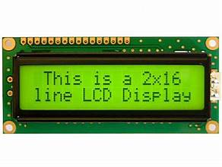
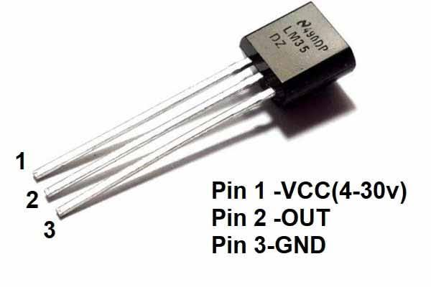
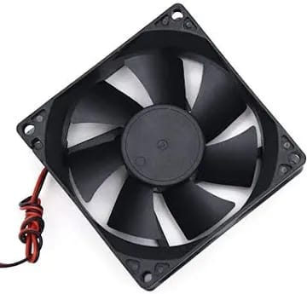

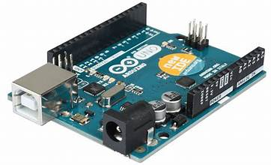
Components Used :
16*2 LCD display
LM 35 temperature senser
Arduino uno
12V DC Fan
12V-2A Adapter

Slide 6
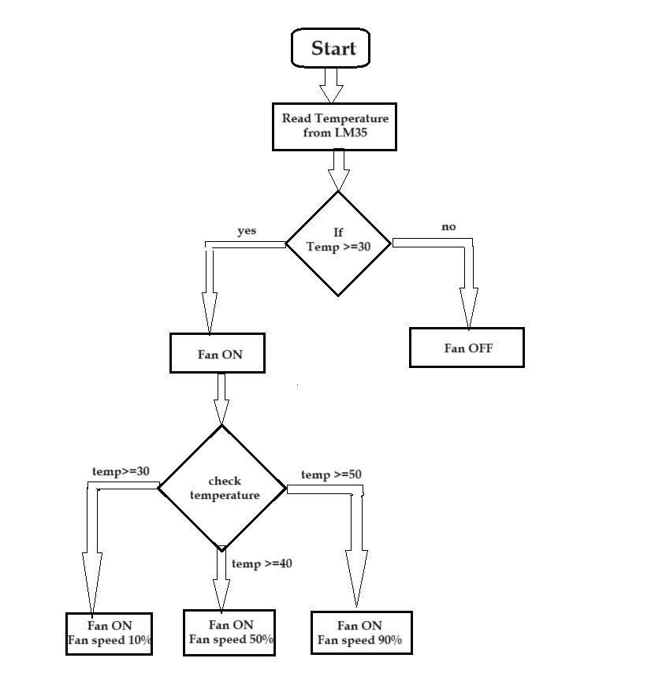
Block Diagram :

Slide 7
Applications :-
HVAC Systems: Used in heating, ventilation, and air conditioning systems to regulate indoor climate efficiently by adjusting fan speed according to the ambient temperature.
Computer Cooling: Integrated into computer systems to manage cooling fans, preventing overheating of components such as CPUs and GPUs, which can improve performance and extend hardware life.
Industrial Machinery: Applied in industrial equipment to control ventilation fans, ensuring machinery operates within safe temperature ranges and reducing the risk of overheating.
Automotive Climate Control: Utilized in vehicles to manage cabin air temperature by adjusting the blower fan speed, enhancing passenger comfort.
Home Appliances: Found in appliances like refrigerators and air purifiers, where they help maintain optimal operating temperatures and improve energy efficiency.

Slide 8
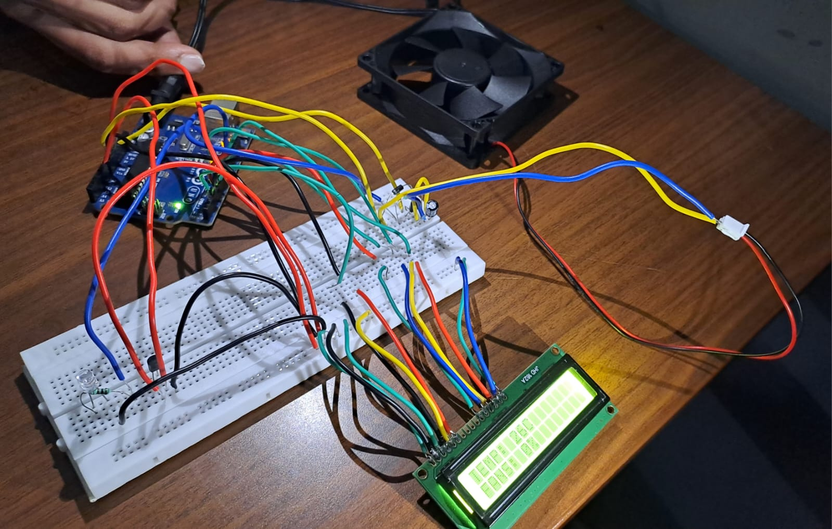
Expected Outcomes:-

Slide 9
Conclusion :
A temperature-based fan speed controller enhances thermal management by adjusting fan speeds according to real-time temperature. This results in improved cooling efficiency, lower energy use, and reduced noise, making it an effective solution for optimizing performance and extending equipment lifespan.

Slide 10
Thankyou

